Slide 1

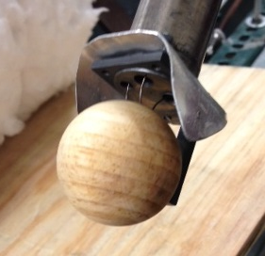
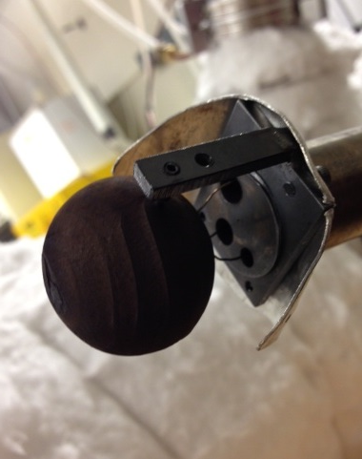
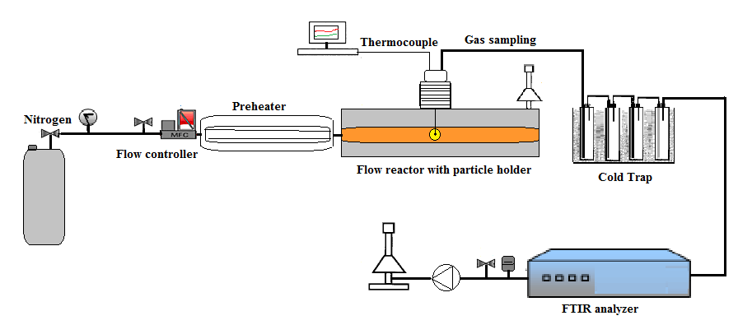
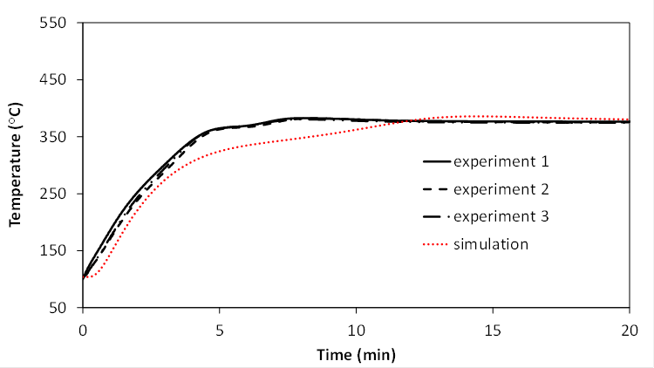
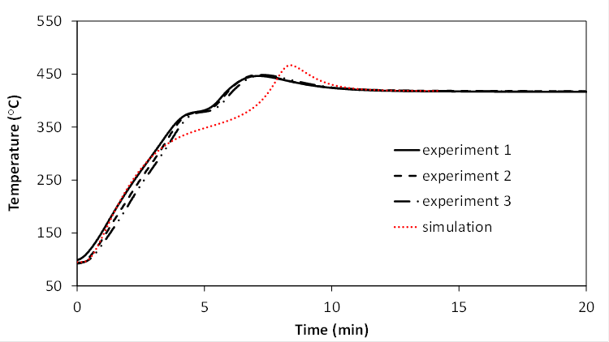
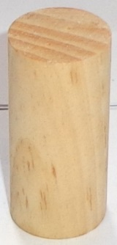
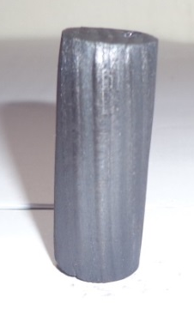
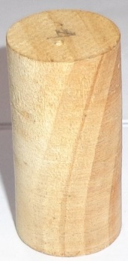
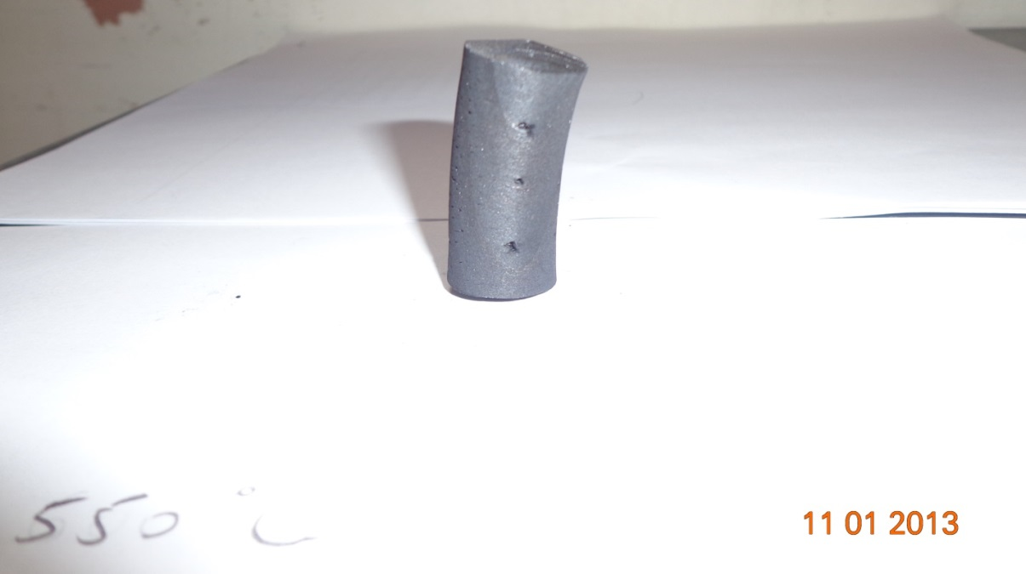
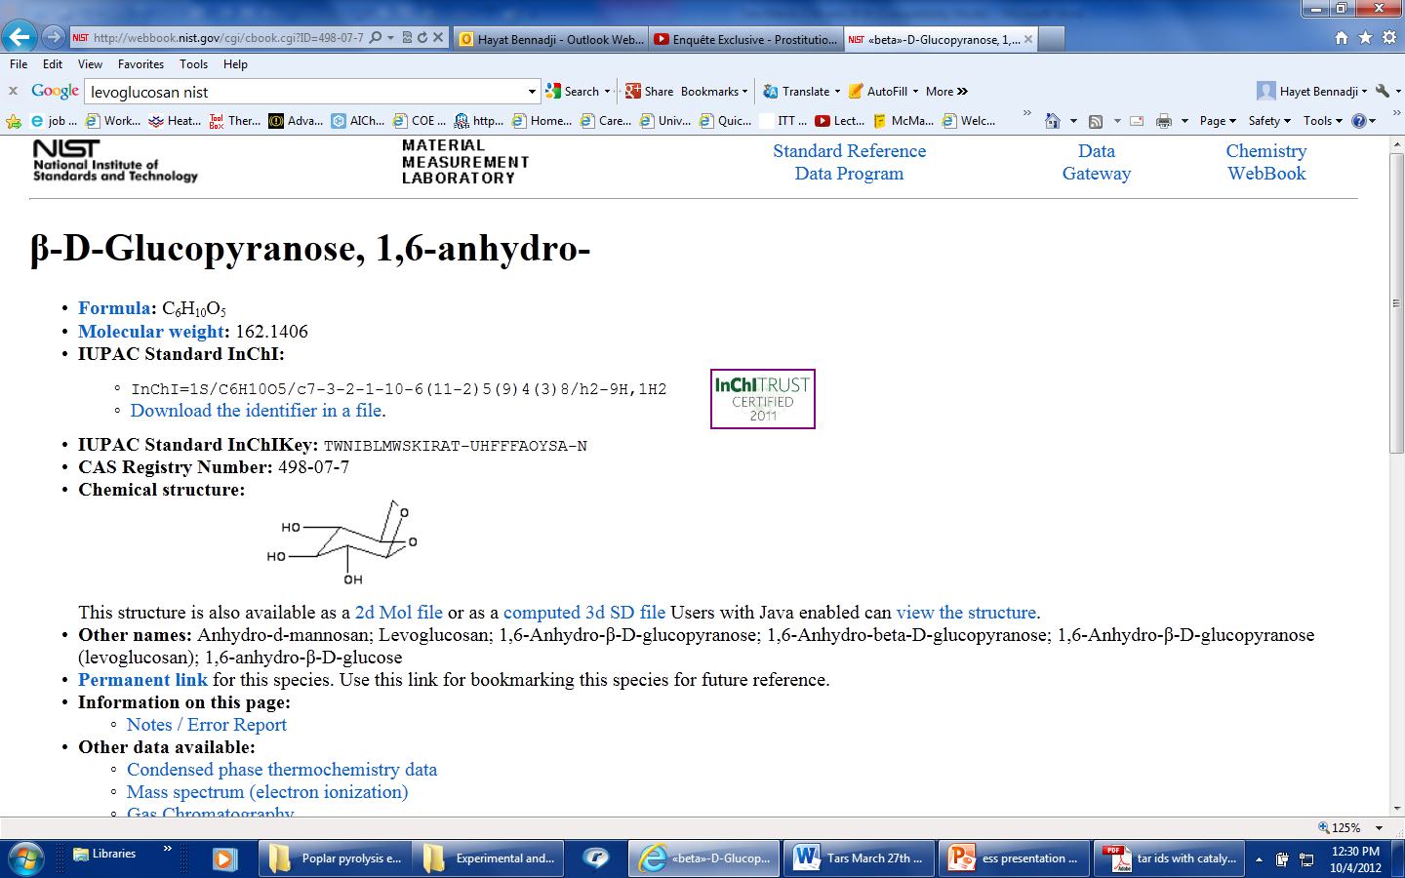
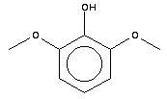
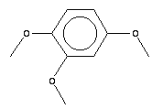
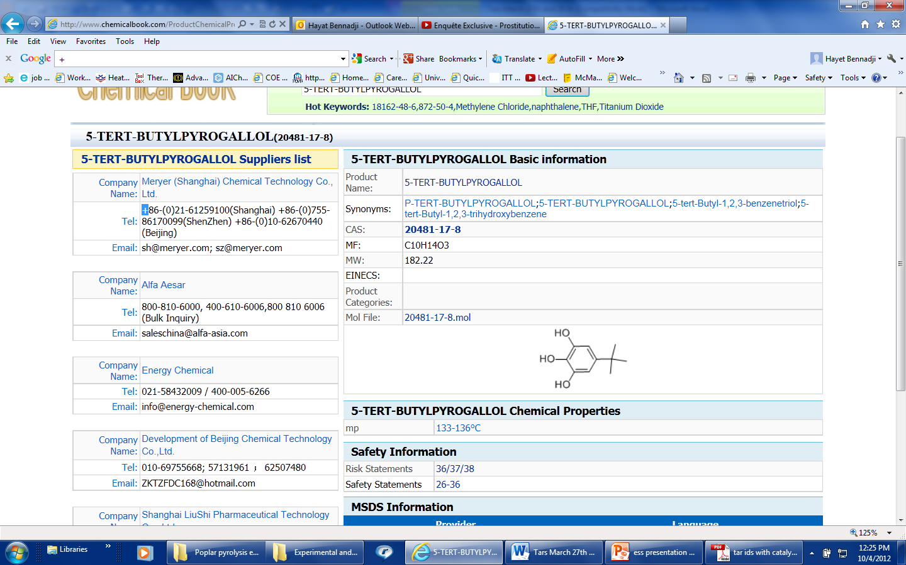
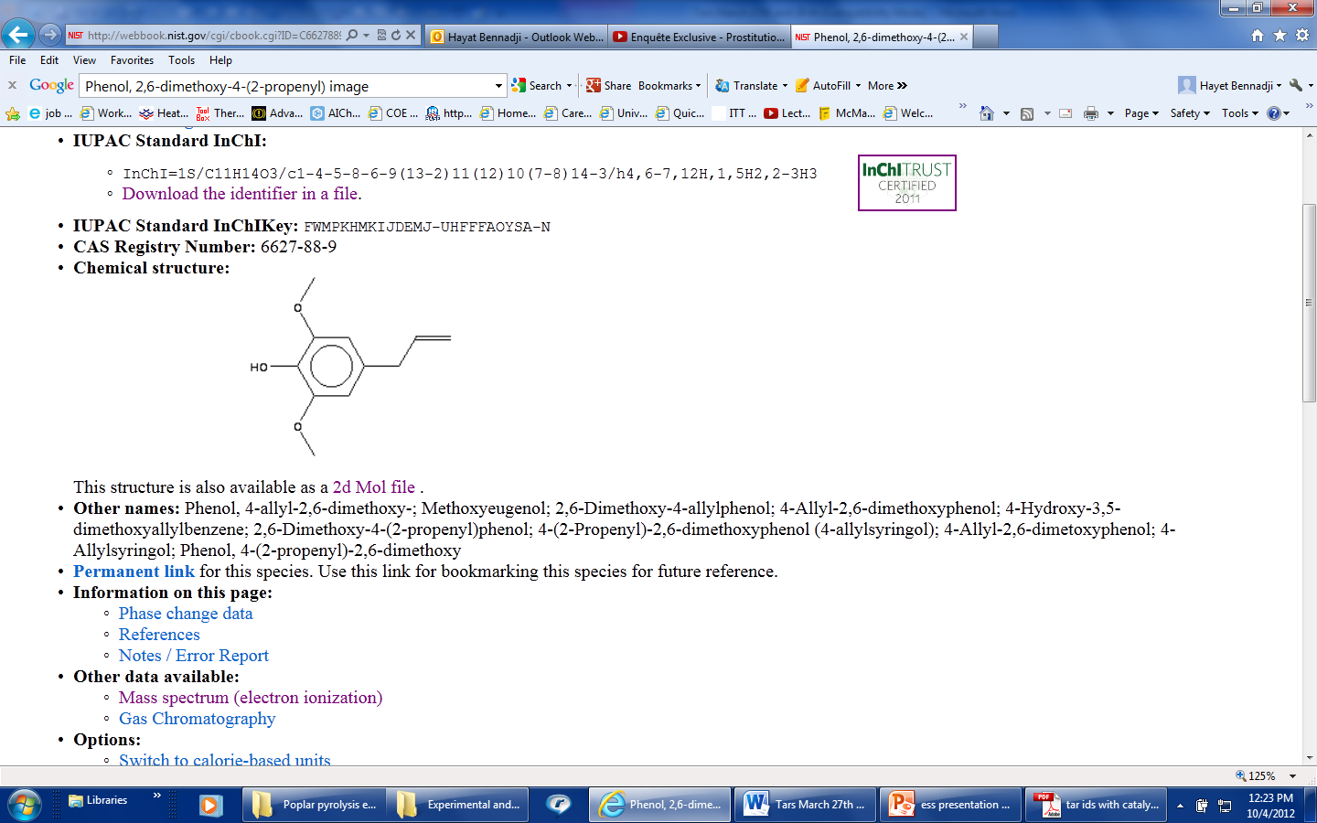
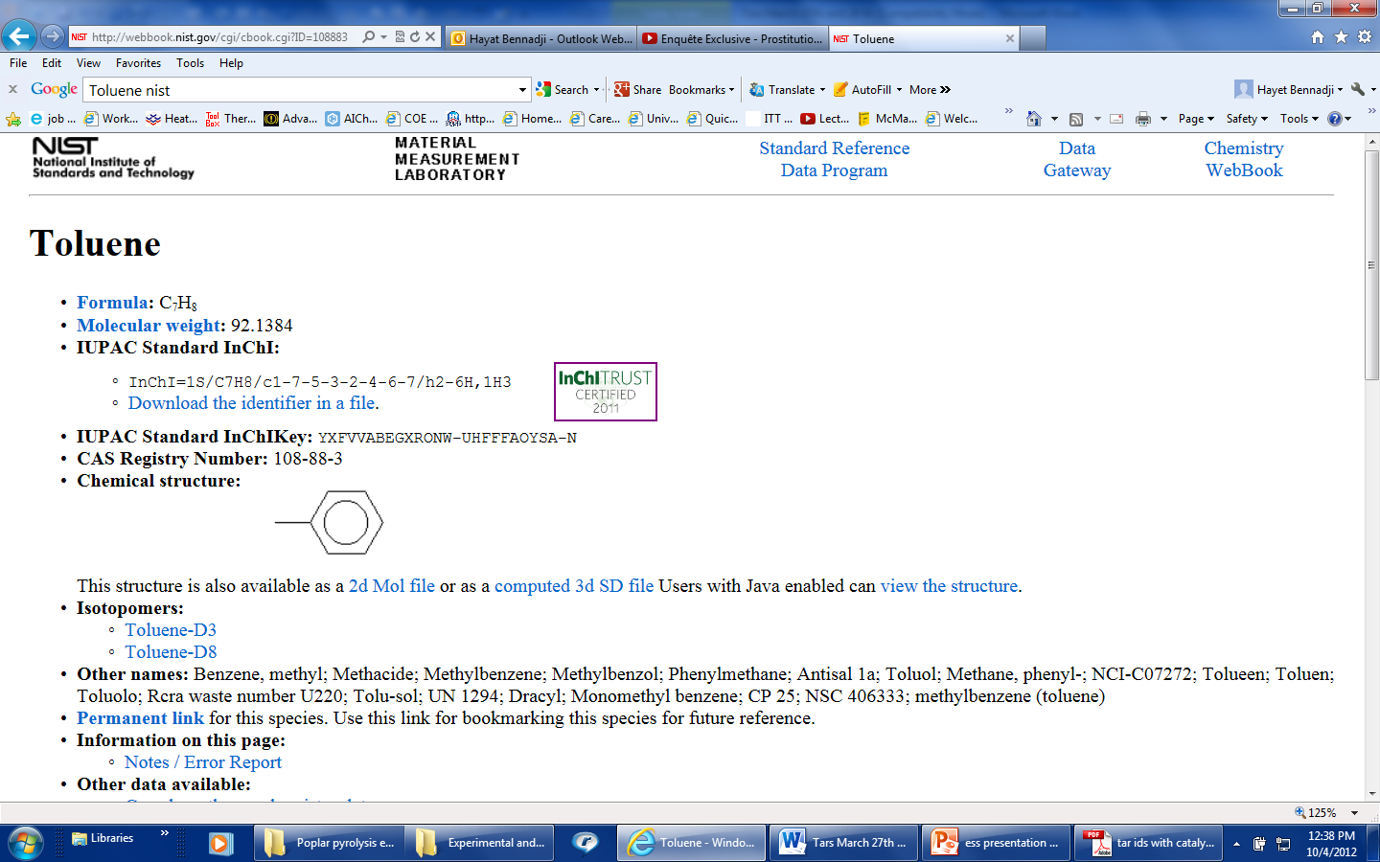


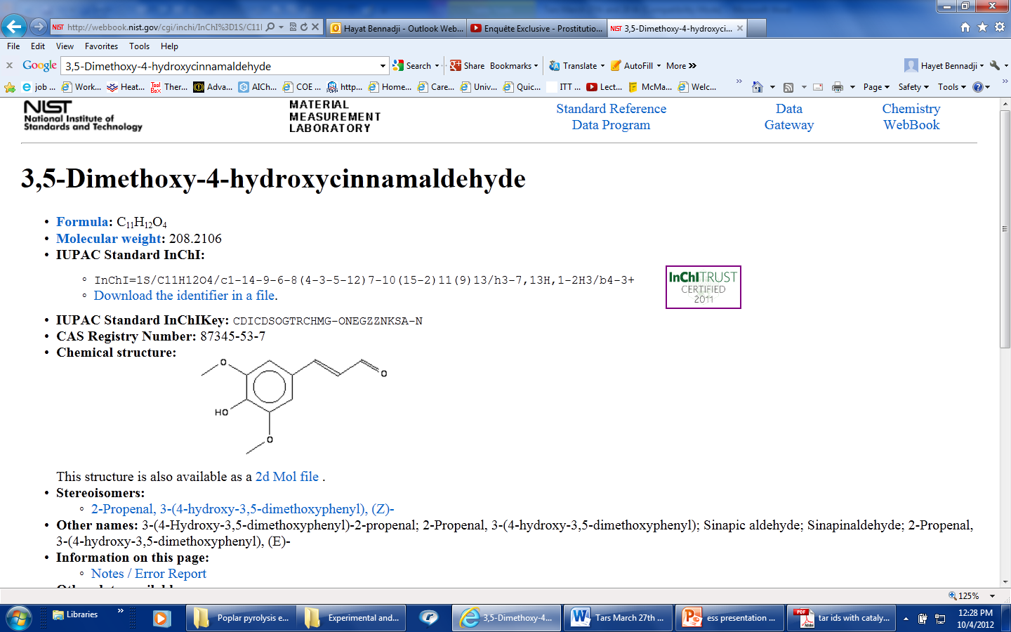
Woody Biomass Pyrolysis: Bench-Scale Experiments and Modeling
05/23/2018
Syngas
Convective Heating
Hayat Bennadji ª, Krystle Smith ª, Shaka Shabangu ^{a,b}, Mishal Shah ª, Lei Deng ^{a,c}, and Elizabeth M. Fisher ª
ª Sibley School of Mechanical and Aerospace Engineering, ^{b}Department of Soil and Crop Sciences, Cornell University, Ithaca, NY, USA
^{c} Xi’an Jiaotong University. Xi’an, 710049,China
Conduction and Pore Convection
Tars (Bio-oil)
ACKNOWLEDGEMENT
Funding provided by Yossie Hollander and the Fondation des Fondateurs
Char
INTRODUCTION
In the Cornell’s pyrolysis; large biomass particles will be processed. Thus, heat and mass transfer resistances are expected. Significant internal temperature gradients influence the solid conversion and the amount and composition of the products obtained. A good understanding of the interaction between chemical and physical mechanisms during the thermal degradation of thermally thick particles of wood is of fundamental importance, for optimizing the conversion process. Computational models have been developed and tested through single particle pyrolysis experiments with a known geometry and well-defined conditions. Our work has investigated effects of particle size, wood type, mineral content, temperature, and grain direction on pyrolysis rates as well as and product composition (tar, gas, and char yields). The computational model can now be applied to choose kiln operating conditions and predict yields.
DESCRIPTION OF THE NUMERICAL MODELS
k_{g}
Gas
k_{g2}
One-dimensional,
Pressure-driven convection described by Darcy’s law,
Diffusion neglected,
Effective thermal conductivity includes radiation through pores,
Two kinetic mechanisms:
  4-species Park* mechanism
  ~30-species Corbetta mechanism
EXPERIMENTAL SETUP
Wood
k_{t}
Tar
k_{c2}
particle holder,
before and
after pyrolysis
k_{is}
Intermediate solid
k_{c}
Char
*W.C . Park, A. Atreya, H.R. Baum. “Experimental and theoretical investigation of heat and mass transfer processes during wood pyrolysis.” Combustion & Flame 157 (2010) 481-494.
**Corbetta, Frassoldati et al., “Pyrolyisis of centimeter-scale woody biomass particles: kinetic modeling and experimental validation, Energy and Fuels 48(11) 6492-6499, 2014
COMPARISON BETWEEN EXPERIMENTAL AND SIMULATED TEMPERATURE HISTORIES
T_{gas} = 375 °C
T_{gas} = 418 °C
EXPERIMENTAL CONDITIONS
SPECIES YIELDS
Gas temperature | 375 °C, 418 °C, 464 °C
Duct Reynolds number | ~5000
Size and shape | Cylinders: d=1.9 cm; L=4 cm Spheres: 2.54 cm, 3.81 cm
Biomass types | Poplar, white pine heartwood, white pine sapwood, corn stover, potassium-doped wood
2.54-cm spheres
3.81-cm spheres
The temperature history is characterized by two distinct events: the first an endothermic reaction, followed by an exothermic reaction.
EFFECT OF WOOD GRAIN DIRECTION
 | Parallel grain | Cross grain
Side view
Top view
374 C
418 C
CHEMICAL COMPOSITION OF TARS
The GC/MS tar analysis indicates the presence of large quantities of oxygenated aromatic compounds (~30) such as phenols , methoxybenzenes and levoglucosan.
EFFECT OF MINERAL CONTENT
464 C
Tars from poplar pyrolysis at T_{gas} = 375 °C
1
0.25
COMPARISON BETWEEN EXPERIMENTAL AND SIMULATED SPECIES PROFILES
Production rate [mg/s/ginit]
CO
0.25
CH3COOH
0.020
H2
0.20
CO2
0.20
CH3OH
0.015
CH4
0.15
HCHO
HAA
HCOOH
CO
0.15
H2
0.10
CO2
0.10
CH3OH
0.010
CH4
HCHO
0.005
HCOOH
0.05
0.05
Production rate [mg/s/ginit]
0.00
Production rate [mg/s/ginit]
Kinetics of heat release are much faster for wood doped with KCl (blue, green) or K₂CO₃ (red) than for undoped wood (black).
0
400
Time [s]
800
1200
0.00
0
400
Time [s]
800
1200
0.000
0
400
800
1200
2.54-cm wood spheres at 368 C
Time [s]
CONCLUSIONS
Important gaseous and light volatile species have been identified and quantified, and the timing and of their production during pyrolysis has been determined. Heating conditions and particle sizes are similar to those in pyrolysis kiln.
Detailed kinetic model has been refined to reflect our reaction thermochemistry findings.
Mineral content of biomass strongly affects processing time and pyrolysis conditions
FUTURE WORK
Compare predictions to pilot-scale (kiln) data
  Products
  Completeness of pyrolysis
Investigate additional parameters (moisture content…)

