Slide 1
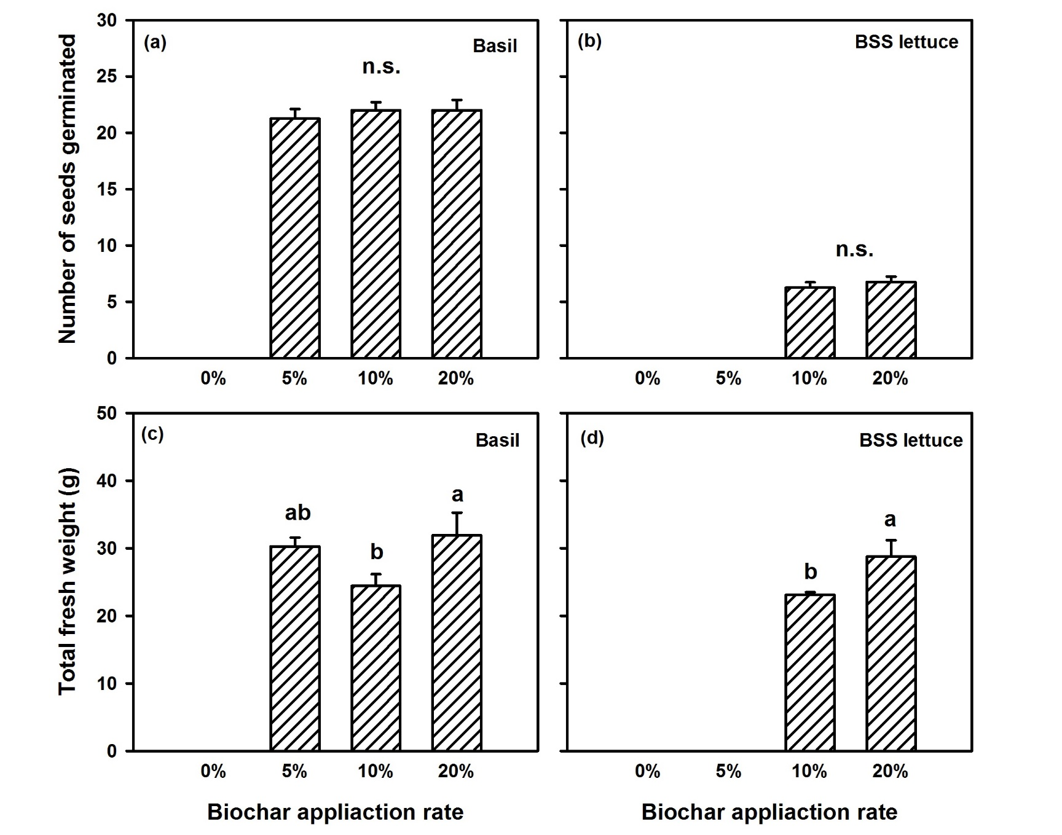
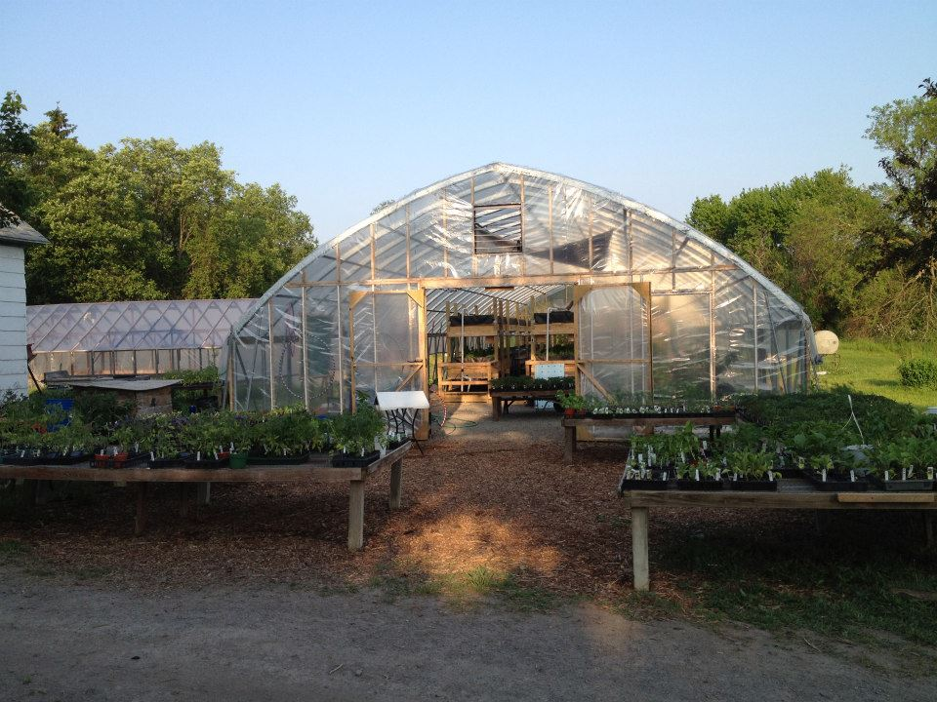
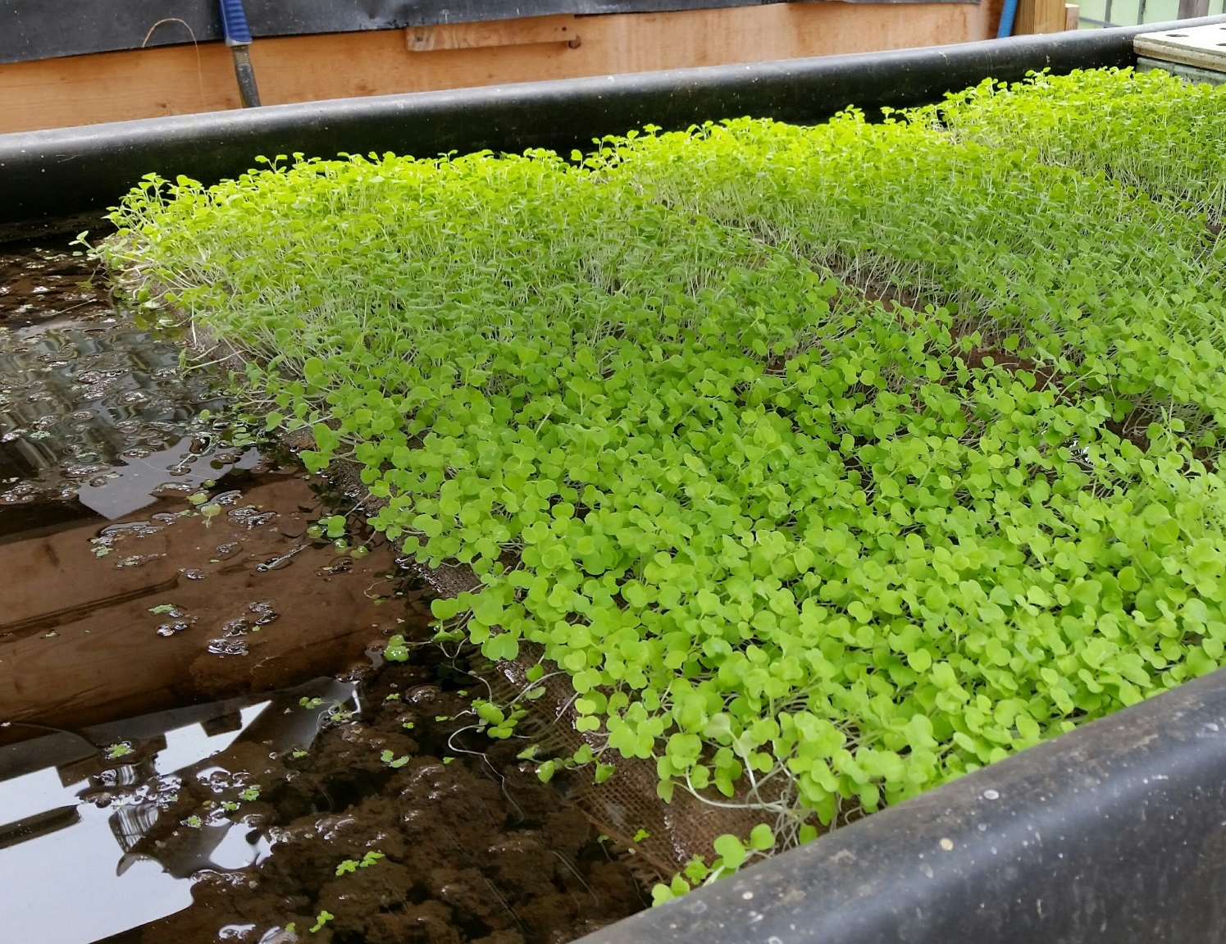
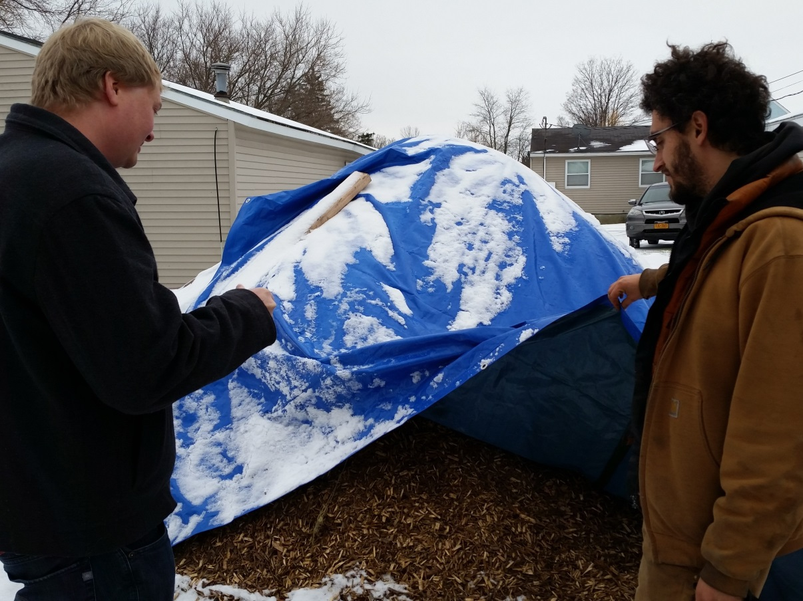
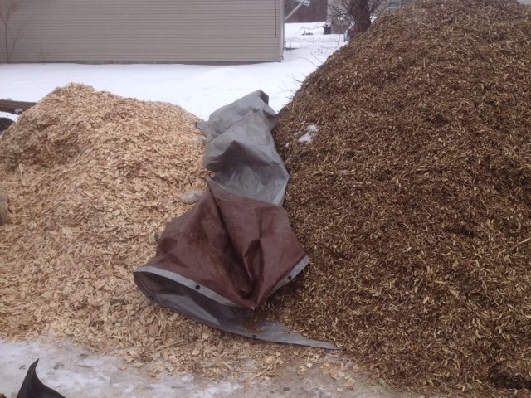
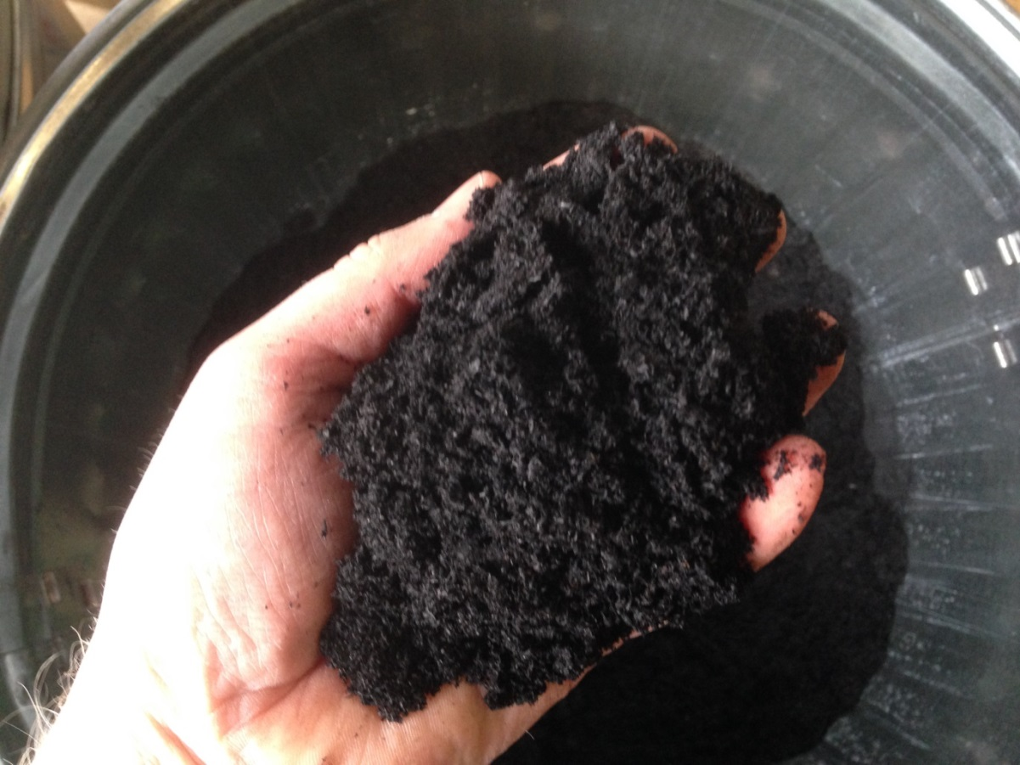
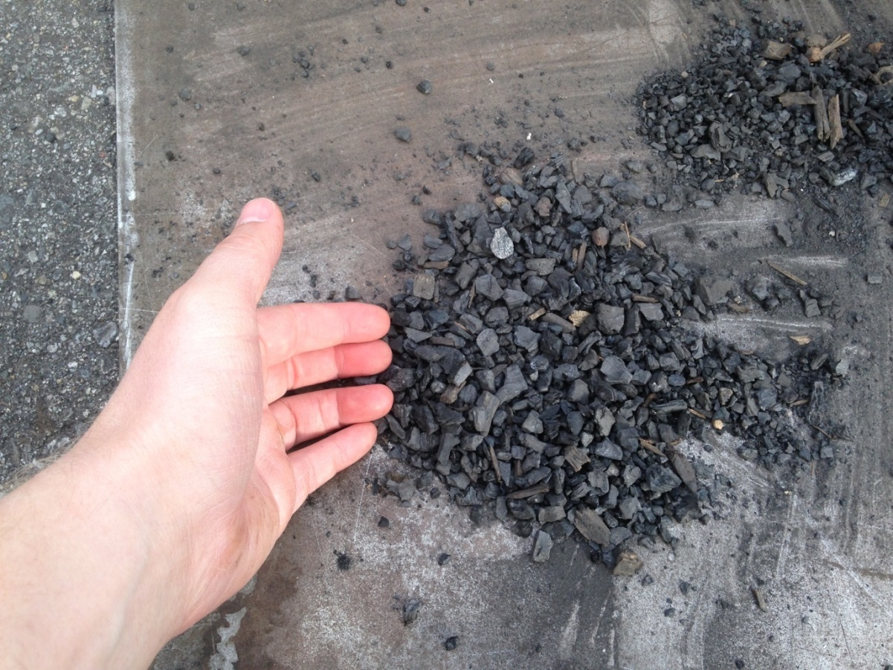
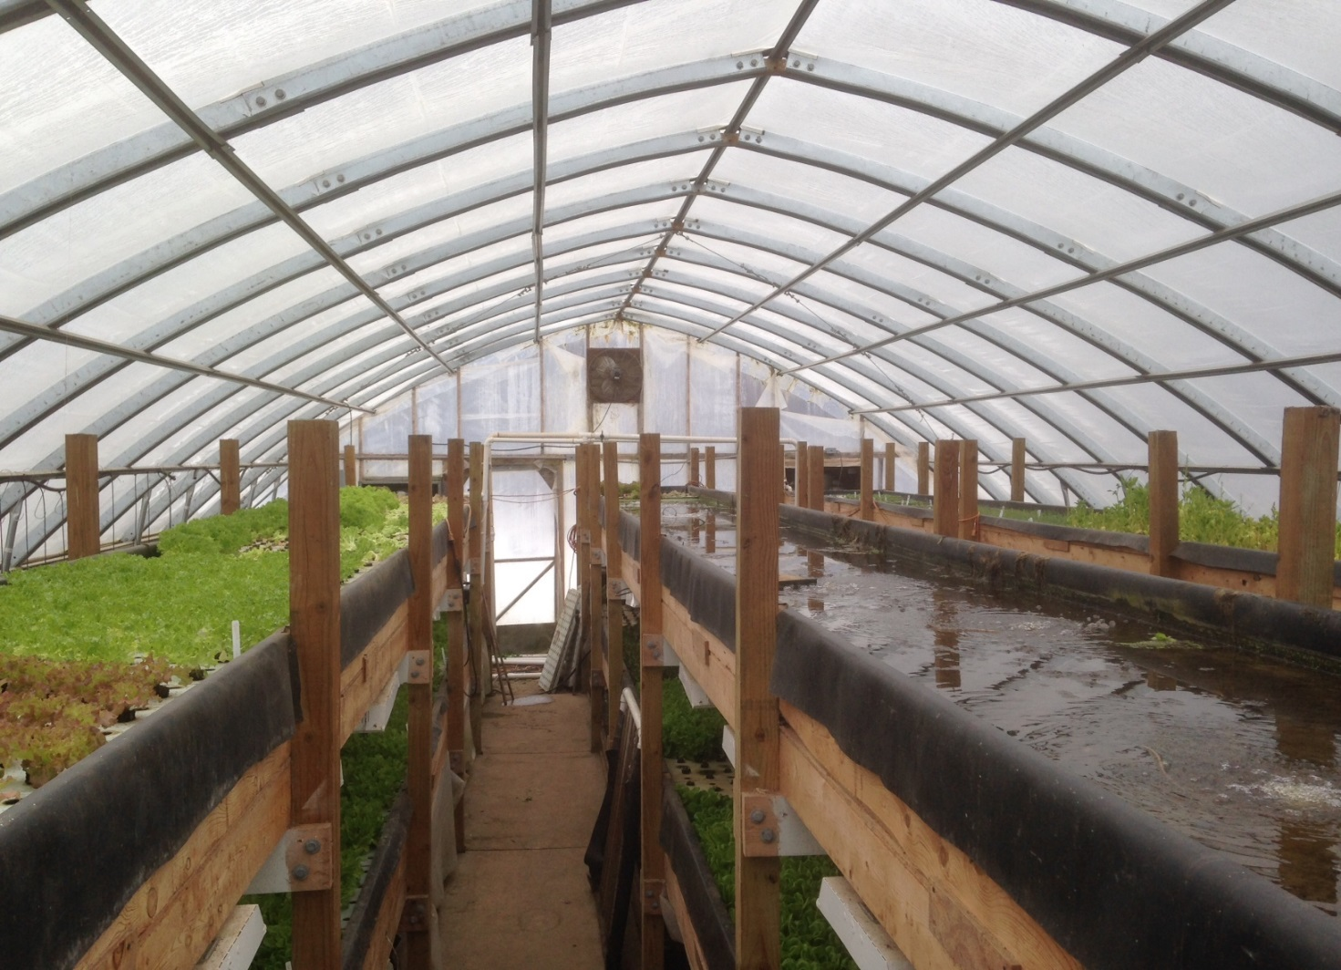
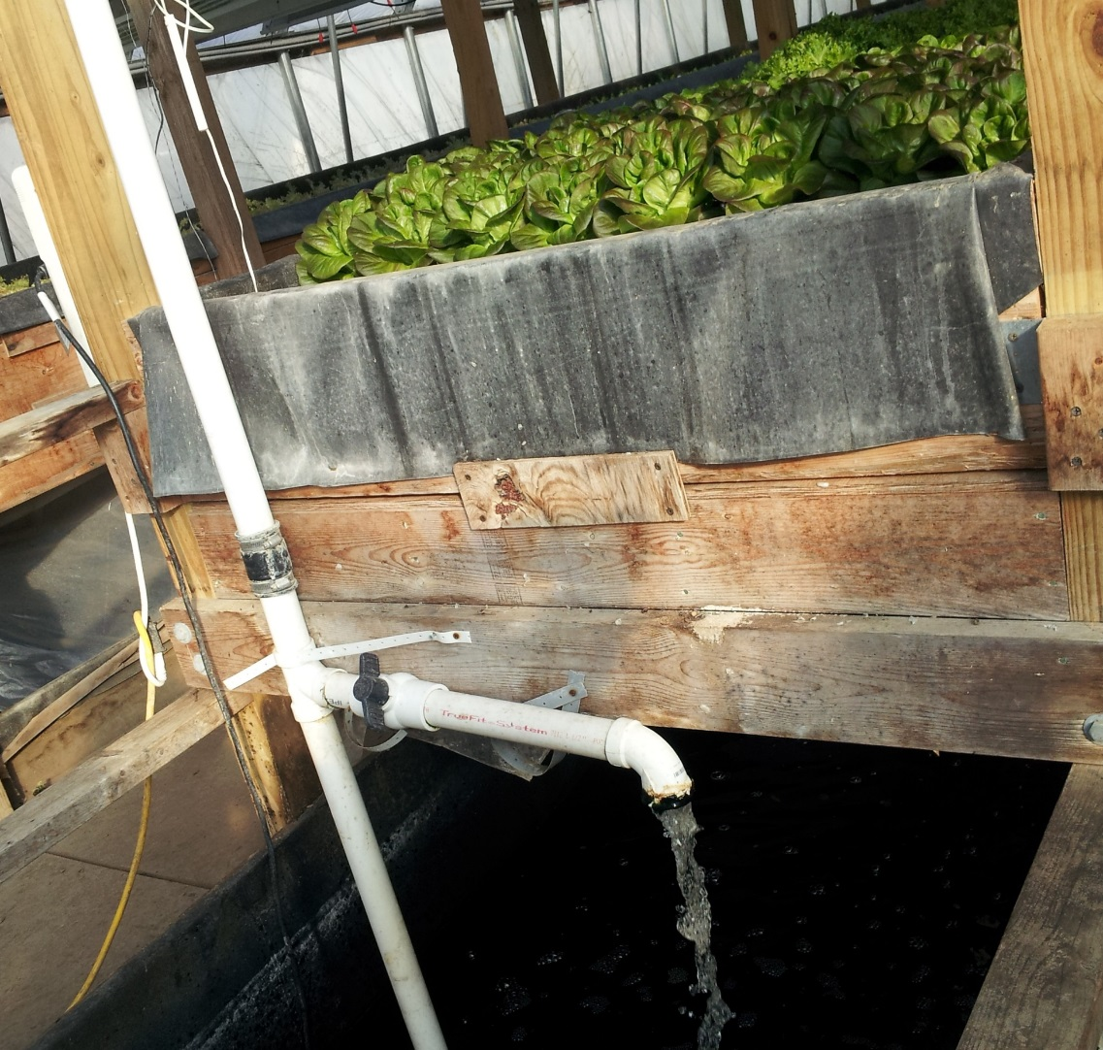
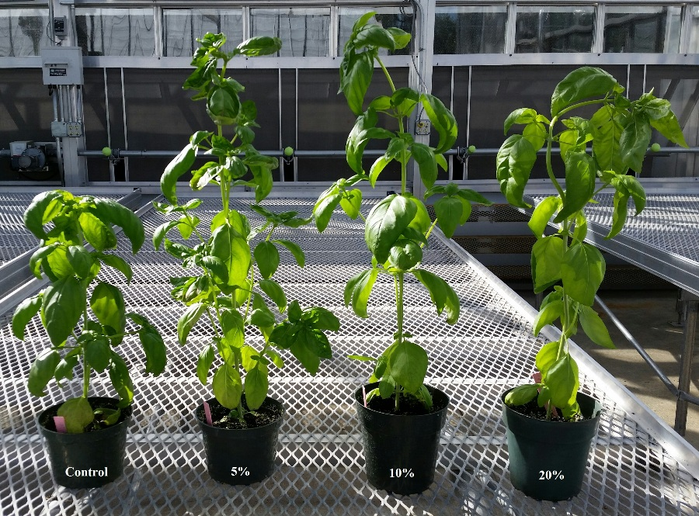
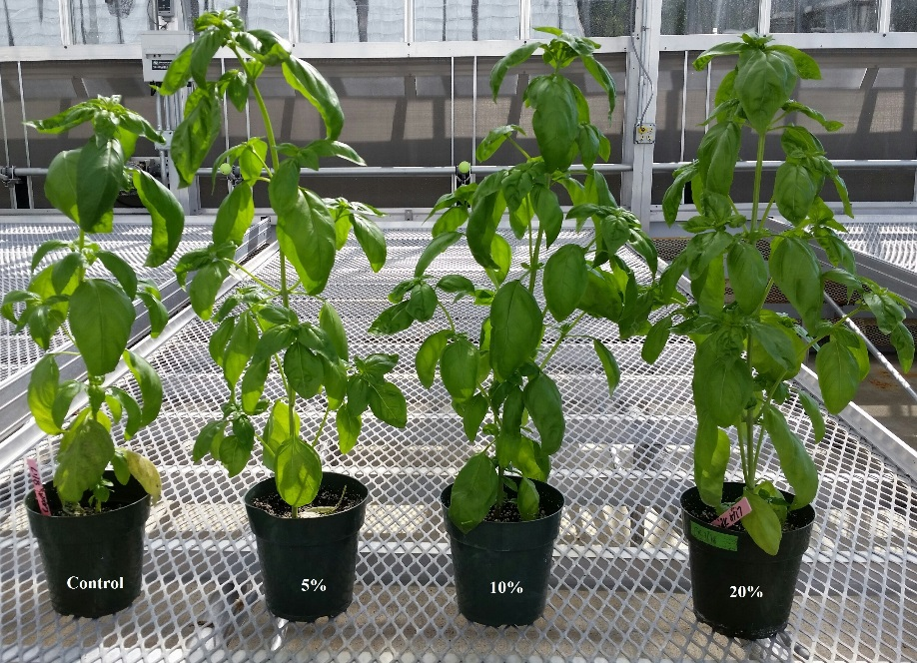
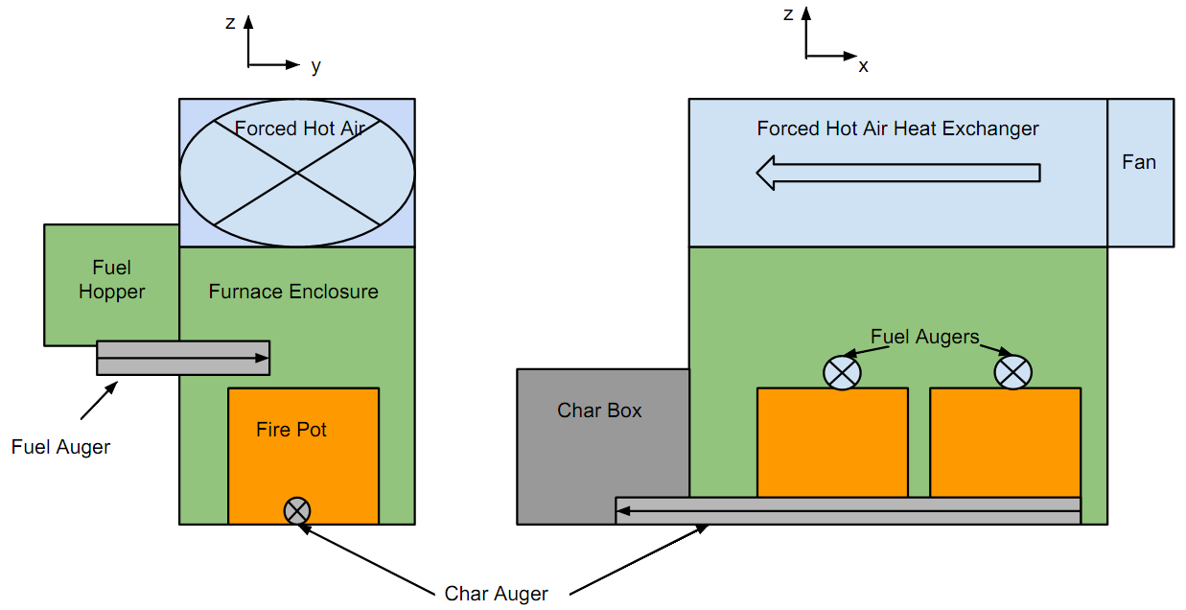
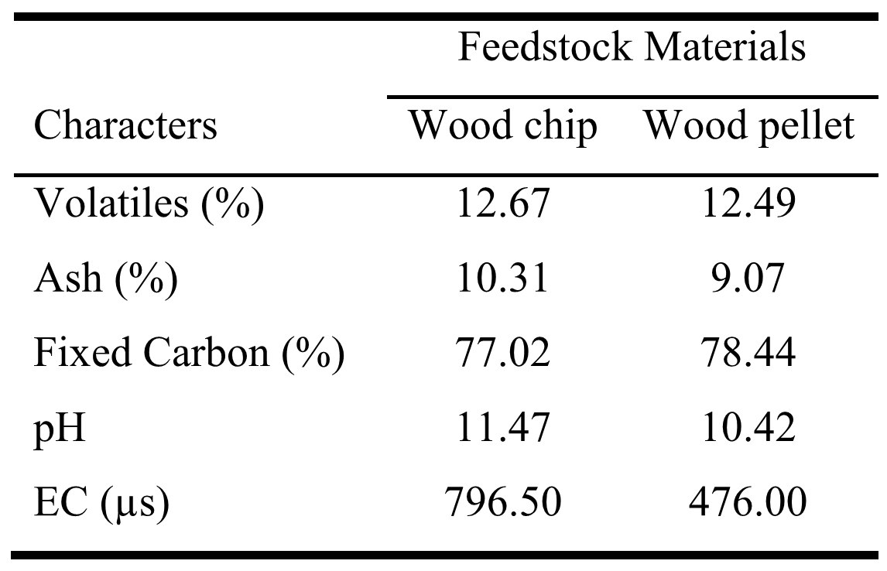
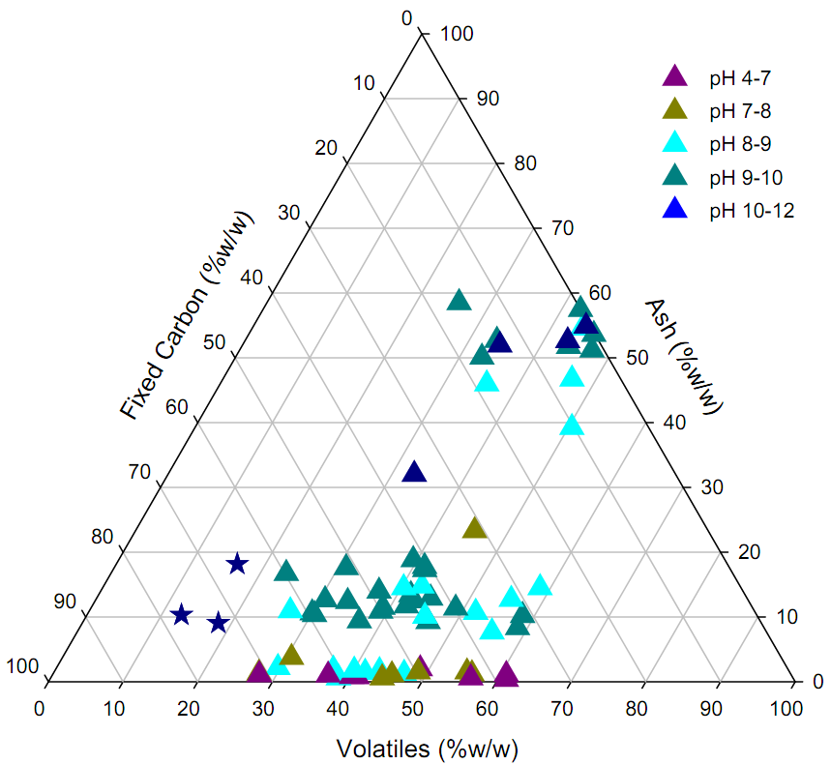
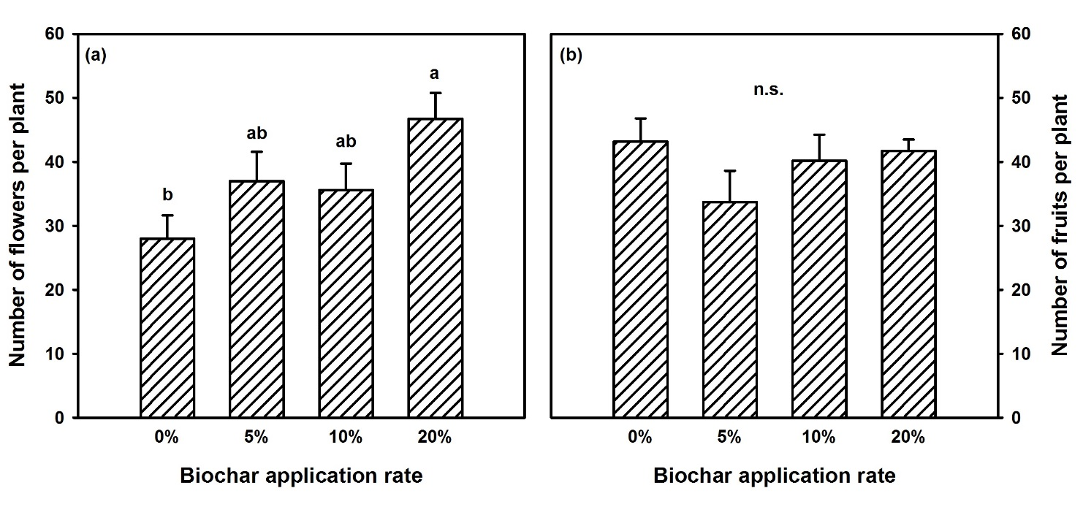
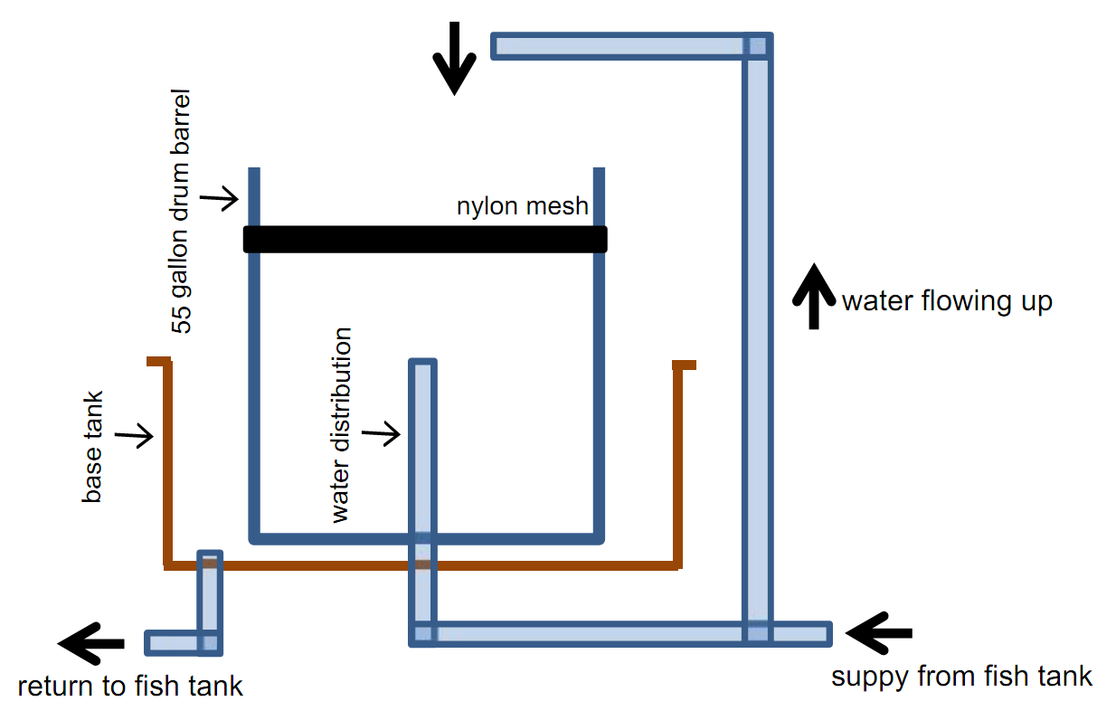
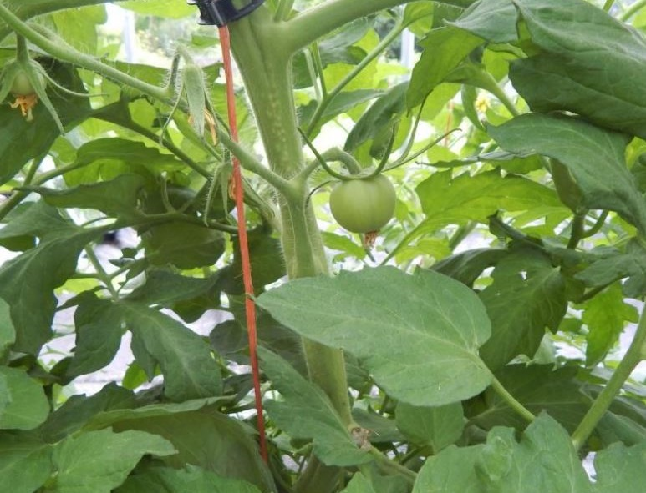
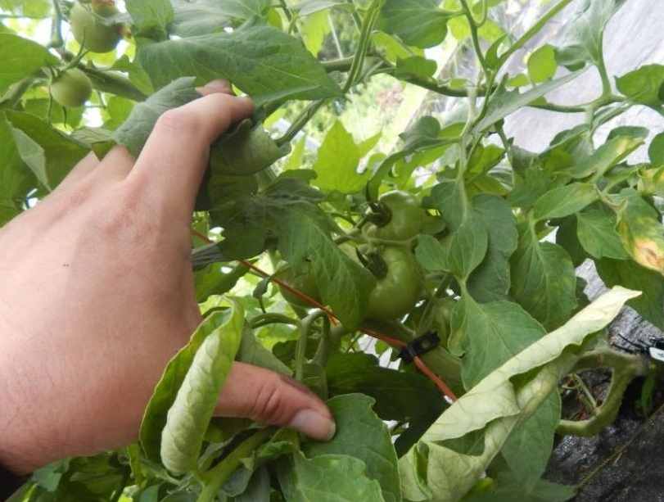
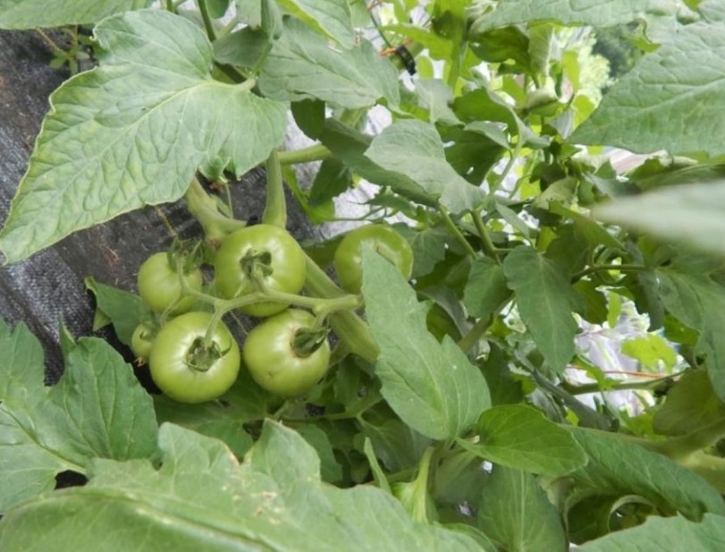
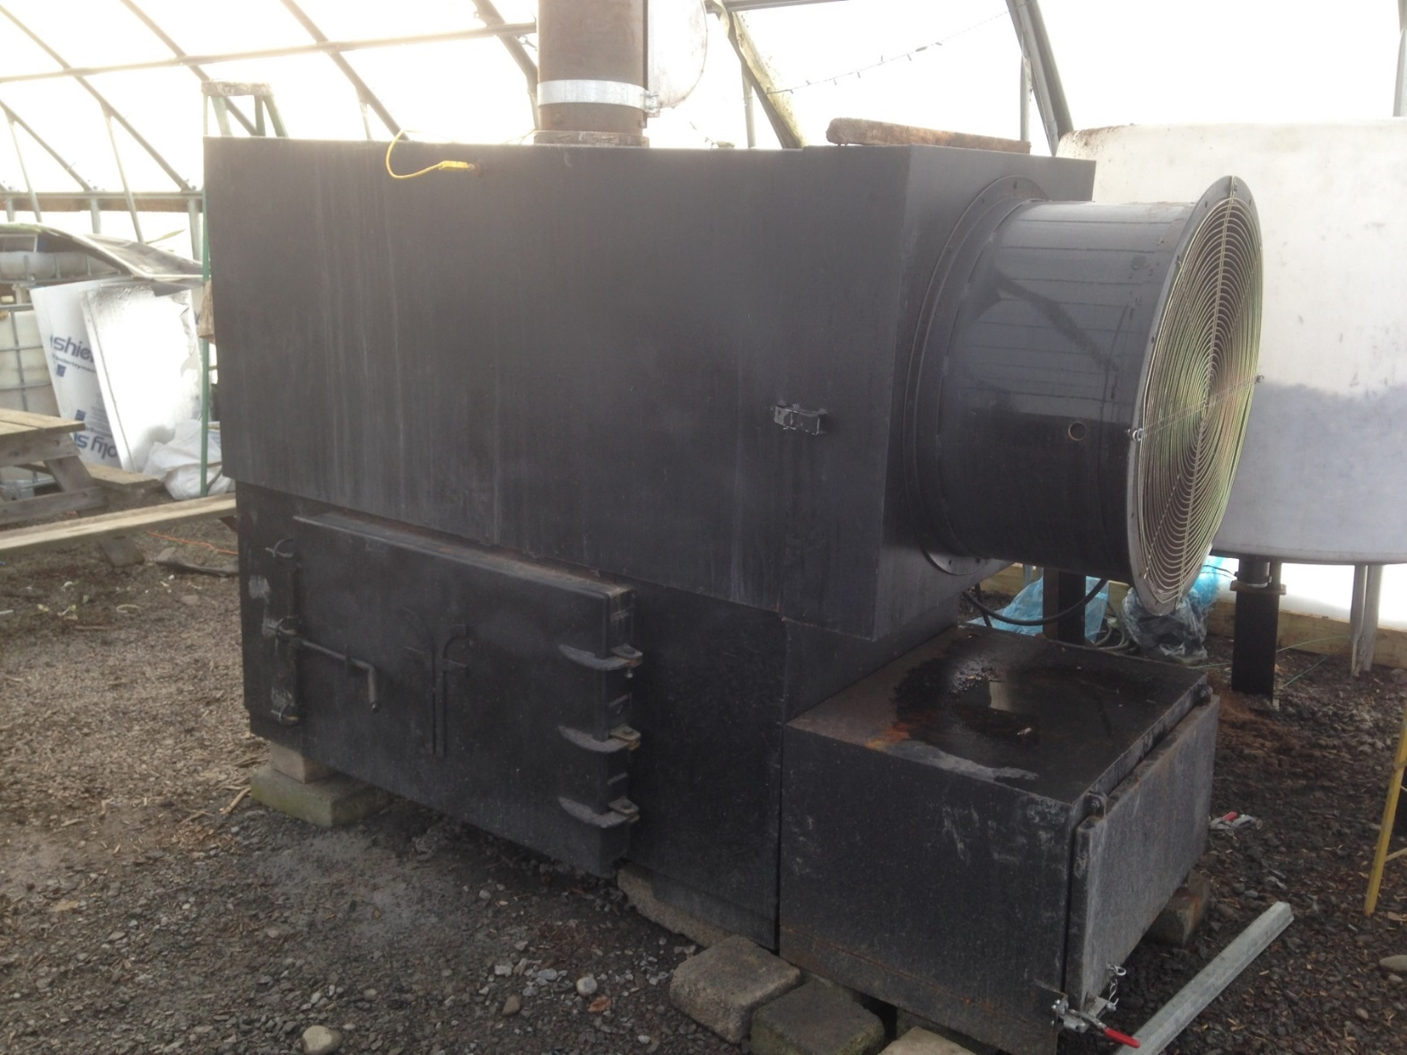
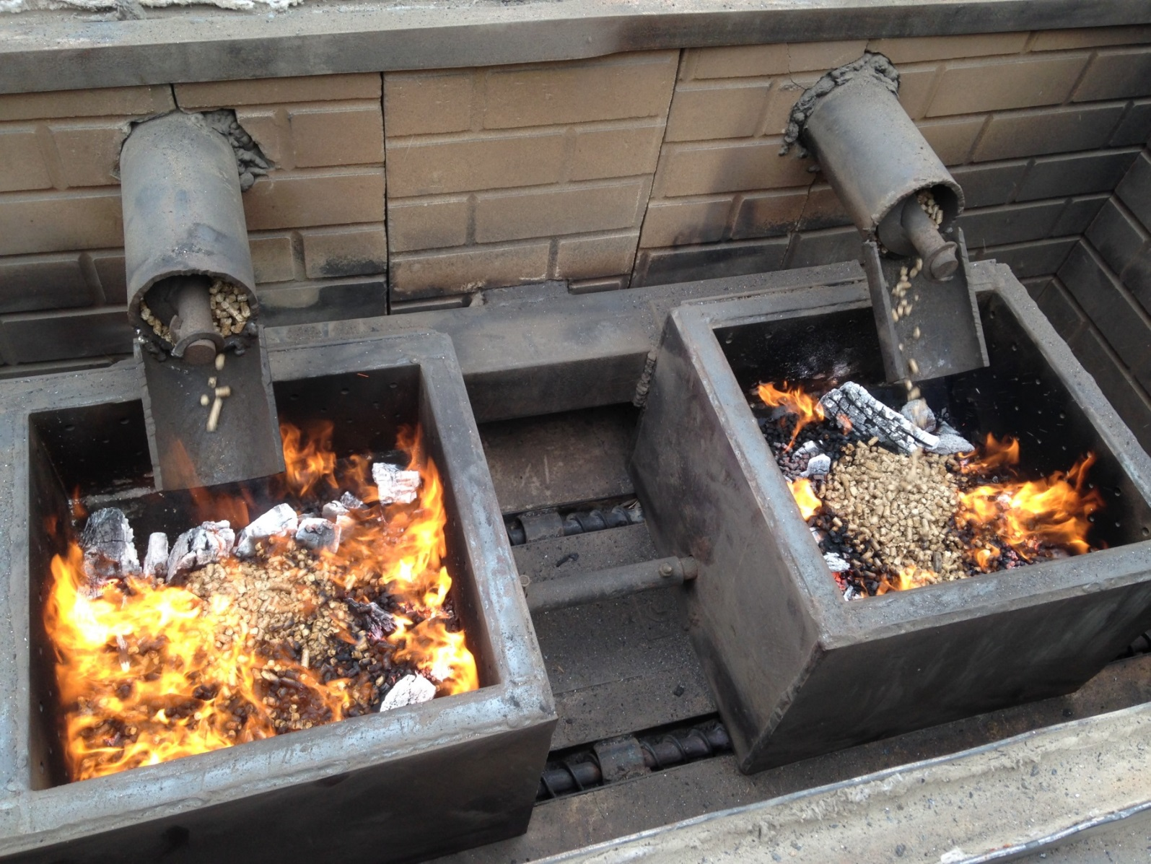
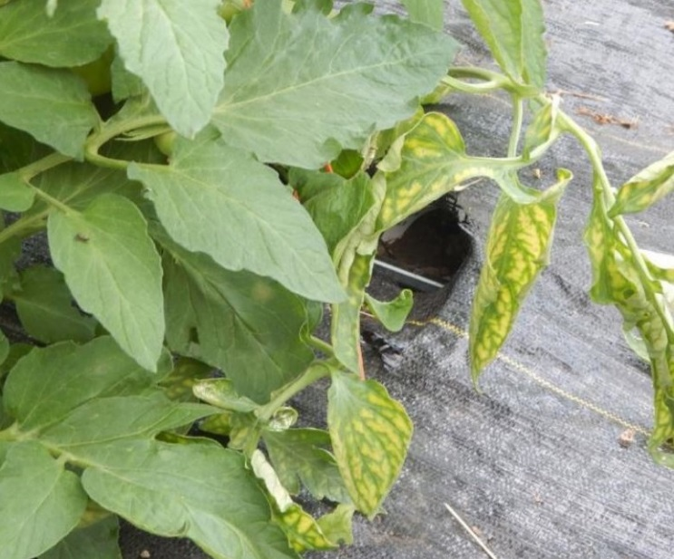
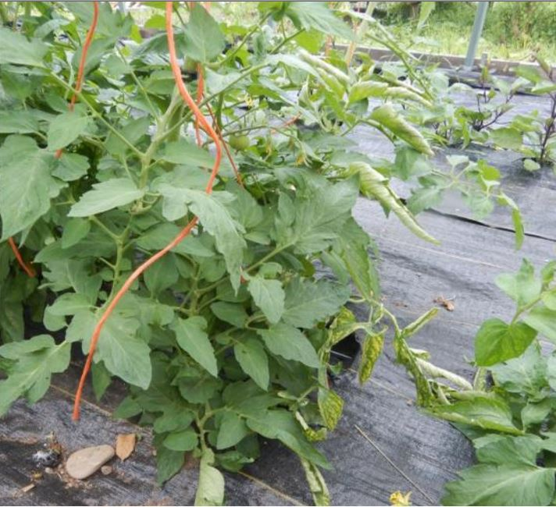
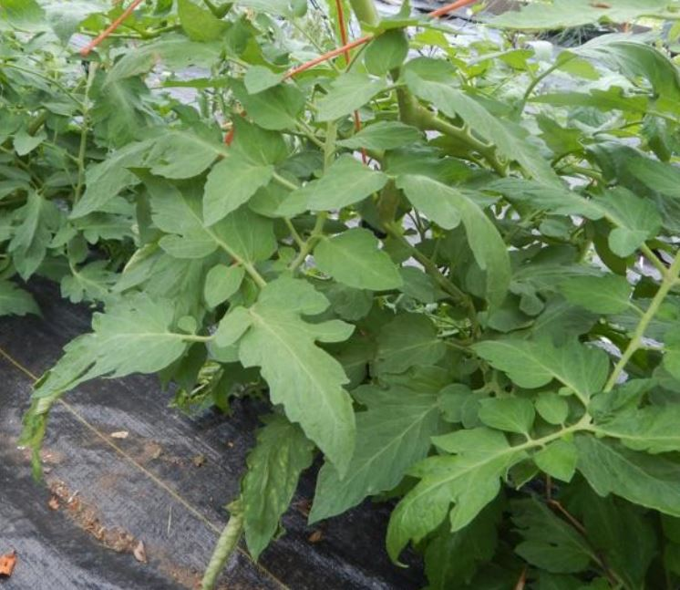
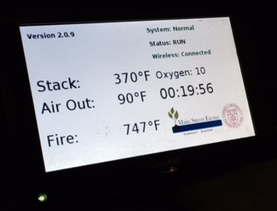
Managing Organic Wastes through Pyrolysis to Reduce Fossil Fuel Consumption and Increase Sustainability
in the Greenhouse and Aquaculture Industries
Neil S. Mattson and Jingjing Yin, School of Integrative Plant Science, Cornell University, Ithaca, NY, USA
Introduction
Feedstocks and biochar
Results: Seed germination (commercial biochar)
Main Street Farms
Local year-round vegetable production requires high energy inputs for heating a greenhouse and high fertilizer inputs
Biochar (agricultural charcoal) is produced by heating a feedstock under low oxygen conditions (pyrolysis). Biochar can improve soil structure and health
Americans generate 251 million tons annually of municipal solid waste (55% is organic materials, including 13% for yard trimmings)
Combining small-scale affordable pyrolysis of organic waste materials with industries that need large amounts of heat energy can reduce fossil fuel use while providing biochar for agricultural use and reducing landfill waste.
Furnace feedstock is an important factor that determines biochar characteristics and fuel efficiency
Several locally sourced feedstocks are being tested including: municipal wood chips, willow chips, wood pellets cherry pits, coffee chaff, etc.
The resulting biochar is characterized in a lab and is being tested as a soil amendment in plant growth trials
Main Street Farms is a small diversified farm, organic plant nursery, and education center. Their vegetables are grown using aquaponics, high tunnels and other environmentally friendly methods in Cortland and Homer, NY. Their mission is to grow healthy, nutritious food, in a sustainable way, for the surrounding communities.
Biochar incorporation promoted seed germination for both basil (any treatment) and lettuce (10% and 20%).
The group with 20% biochar incorporated had the highest fresh weight than the other treatment groups.
Objectives
Results: Seedling transplanting
To install a low cost pyrolysis furnace at the Main Street Farms in Homer, NY, and use locally available residual waste feedstocks to produce biochar on-site and heat the greenhouse;
To determine the suitability of on-site produced biochar as soil amendment and to filter solid fish waste from aquaponic ponds;
To determine if nutrient-enriched biochar can be applied to soil to reduce fertilizer costs while maintaining yield;
To quantify the potential energy cost savings from on-site production of biochar and heat using several feedstocks to fuel the pyrolysis furnace.
Greenhouse at Main Street Farms in Homer, NY.
Microgreens grown in hydroponics
The pyrolysis furnace
Small and large particles of biochar is produced from different types of feedstocks, and has different uses depending on chemical and physical properties.
Tilapia is raising in the tanks underneath the vegetables. Water from the fish tank is pumped to the vegetables.
The pyrolysis furnace was designed by ClearStak LLC, leaders in sensors/emission control systems for biomass furnaces. Following combustion in the burn chamber, what remains of the feedstock is auger-driven into the pyrolysis chamber (char box) which is oxygen-limited. The heat produced from burning feedstock is released for industrial uses through a forced hot air heat exchanger.
Biochar sample characterization
Multi-level aquaponic system in the greenhouse. Vegetables are growing in the ponds of the upper two layers, and fish in a bottom pond.
Biochar from wood chips and pellets was characterized for physical and chemical properties.
Our biochar samples had low volatiles and ash content, and high fixed carbon content which are desirable traits for biochar used in soil amendments and water filtering
Fish tank solid waste filter
Fish solid waste is toxic to fish, and filtration is a significant cost and barrier to aquaculture production. Biochar can capture the nutrients during filtration, and the nutrient-enriched biochar can be applied to soil to reduce the input of fertilizers. In our project, 55-gallon drum barrel will be filled with on-site produced biochar, and filter solid waste from fish tanks.
Results: On-farm tomato trial
Number of fruit were similar among four groups, but 20% biochar group had more flowers than controls (without biochar incorporated).
Fruits were smaller in control groups (a) than that in 10 and 20% biochar groups (b and c).
Table 1. Characteristics of biochar produced from two types of feedstock materials, wood chips and wood pellets.
Figure 1. The percentage of fixed carbon, volatiles, and ash in different types of biochar. Our samples are indicated by stars.
(a)
(b)
(c)
Schematic representation of the pyrolysis furnace
Preliminary experiments
On-campus experiments and on-farm trials were conducted during summer 2015 to test the effects of biochar application rate on seed germination rate and plant growth of lettuce, tomato, and basil.
Biochar application rates of 0%, 5%, 10% and 20% (by volume), were mixed with soil or a peat/perlite soilless potting mix.
Organic certified commercial biochar, hardwood biochar and willow chip biochar were tested respectively.
(d)
(e)
(f)
Schematic representation of the fish tank solid waste filter. – Designed by Dr. Michael Ben Timmons, Cornell University.
Project team members
Cornell University: Neil Mattson, Janice Thies, Johannes Lehmann, Michael Timmons, Jean Bonhotal, Mary Schwarz, Richard Overton, A. Edward Staehr, Jingjing Yin Main Street Farms: Allan Gandelman ClearStak: Nathan Jones Finger Lakes Biochar: Kathleen Draper
Nutrient deficiencies were more observable in control groups (d and e); plants grown with 10 and 20% of biochar were less stressed.

